Slide 1
What is a Hash Table ?
The simplest kind of hash table is an array of records.
This example has 701 records.
[ 0 ]
[ 1 ]
[ 2 ]
[ 3 ]
[ 4 ]
[ 5 ]
[ 700]
. . .
An array of records
Notes:
This lecture introduces hash tables, which are an array-based method for implementing a Dictionary. You should recall that we have seen dictionaries implemented in other ways, for example with a binary search tree. The abstract properties of a dictionary remain the same: We can insert items in the dictionary, and each item has a key associated with it. When we want to retrieve an item, we specify only the key, and the retrieval process finds the associated data.
What we do now is use an array to implement the dictionary. The array is an array of records. In this example, we could store up to 701 records in the array.

Slide 2
What is a Hash Table ?
[ 4 ]
Number 506643548
Each record has a special field, called its key.
In this example, the key is a long integer field called Number.
[ 0 ]
[ 1 ]
[ 2 ]
[ 3 ]
[ 4 ]
[ 5 ]
[ 700]
. . .
Notes:
Each record in the array contains two parts. The first part is a number that we'll use for the key of the item. We could use something else for the keys, such as a string. But for a hash table, numbers make the most convenient keys.

Slide 3

What is a Hash Table ?
[ 4 ]
Number 506643548
The number might be a person's identification number, and the rest of the record has information about the person.
[ 0 ]
[ 1 ]
[ 2 ]
[ 3 ]
[ 4 ]
[ 5 ]
[ 700]
. . .
Notes:
The numbers might be identification numbers of some sort, and the rest of the record contains information about a person. So the pattern that you see here is the same pattern that you've seen in other dictionaries: Each entry in the dictionary has a key (in this case an identifying number) and some associated data.

Slide 4
What is a Hash Table ?
When a hash table is in use, some spots contain valid records, and other spots are "empty".
[ 0 ]
[ 1 ]
[ 2 ]
[ 3 ]
[ 4 ]
[ 5 ]
[ 700]
Number 281942902
Number 233667136
Number 506643548
. . .
Number 155778322
Notes:
When a hash table is being used as a dictionary, some of the array locations are in use, and other spots are "empty", waiting for a new entry to come along.
Oftentimes, the empty spots are identified by a special key. For example, if all our identification numbers are positive, then we could use 0 as the Number that indicates an empty spot.
With this drawing, locations [0], [4], [6], and maybe some others would all have Number=0.

Slide 5
Inserting a New Record
Number 580625685
Hashing allows you search elements very fast O(1) time.
Link list searches at O(N) time
Binary tree searches at O(logN) time.
[ 0 ]
[ 1 ]
[ 2 ]
[ 3 ]
[ 4 ]
[ 5 ]
[ 700]
Number 281942902
Number 233667136
Number 506643548
. . .
Number 155778322
Notes:
In order to insert a new entry, the key of the entry must somehow be converted to an index in the array. For our example, we must convert the key number into an index between 0 and 700. The conversion process is called hashing and the index is called the hash value of the key.

Slide 6
Inserting a New Record
Number 580625685
In order to insert a new record, the key must somehow be converted to an array index.
The index is called the hash value of the key.
[ 0 ]
[ 1 ]
[ 2 ]
[ 3 ]
[ 4 ]
[ 5 ]
[ 700]
Number 281942902
Number 233667136
Number 506643548
. . .
Number 155778322
Notes:
In order to insert a new entry, the key of the entry must somehow be converted to an index in the array. For our example, we must convert the key number into an index between 0 and 700. The conversion process is called hashing and the index is called the hash value of the key.

Slide 7
Inserting a New Record
Number 580625685
The hash value is used for the location of the new record.
[ 0 ]
[ 1 ]
[ 2 ]
[ 3 ]
[ 4 ]
[ 5 ]
[ 700]
Number 281942902
Number 233667136
Number 506643548
. . .
Number 155778322
Notes:
So, this new item will be placed at location [3] of the array.

Slide 8
Example
Hash
Table
0
key
1
21
Items
H(X) =
xmod 10
2
21
3
56
4
72
5
39
6
7
48
8
13
9
92

Slide 9
Collisions
Number 701466868
Here is another new record to insert, with a hash value of 2.
My hash
value is [2].
[ 0 ]
[ 1 ]
[ 2 ]
[ 3 ]
[ 4 ]
[ 5 ]
[ 700]
Number 281942902
Number 233667136
Number 580625685
Number 506643548
. . .
Number 155778322
Notes:
Sometimes, two different records might end up with the same hash value.

Slide 10
Collisions Linear Probing
Number 701466868
This is called a collision, because there is already another valid record at [2].
When a collision occurs,
move forward until you
find an empty spot.
[ 0 ]
[ 1 ]
[ 2 ]
[ 3 ]
[ 4 ]
[ 5 ]
[ 700]
Number 281942902
Number 233667136
Number 580625685
Number 506643548
. . .
Number 155778322
Notes:
This is called a collision.
When a collision occurs, the insertion process will move forward through the array until an empty spot is found. Sometimes you will have a second collision...

Slide 11
Example
Hash
Table
0
49
key
1
58
Items
H(X) =
xmod 10
2
9
89
3
18
4
49
5
58
6
7
9
8
18
9
89
H_{i}(49) = (x + f(1)) mod 10
f is a linear function

Slide 12
Searching for a Key
Number 701466868
The data that's attached to a key can be found fairly quickly.
Check that location of the array for the key.
[ 0 ]
[ 1 ]
[ 2 ]
[ 3 ]
[ 4 ]
[ 5 ]
[ 700]
Number 281942902
Number 233667136
Number 580625685
Number 506643548
Number 701466868
. . .
Number 155778322
Notes:
It is fairly easy to search for a particular item based on its key.

Slide 13
Example
Hash
Table
0
key
1
Items
H(X) =
xmod 10
2
10
3
20
4
30
5
40
6
7
50
8
60
9
70
Hi(X) = (x + f(i)) mod 10
f is a linear function

Slide 14
Searching for a Key
Number 701466868
When the item is found, the information can be copied to the necessary location.
My hash
value is [2].
Yes!
[ 0 ]
[ 1 ]
[ 2 ]
[ 3 ]
[ 4 ]
[ 5 ]
[ 700]
Number 281942902
Number 233667136
Number 580625685
Number 506643548
Number 701466868
. . .
Number 155778322
Notes:
The data from location [5] can then be copied to to provide the result of the search function.
What happens if a search reaches an empty spot? In that case, it can
halt and indicate that the key was not in the hash table.

Slide 15
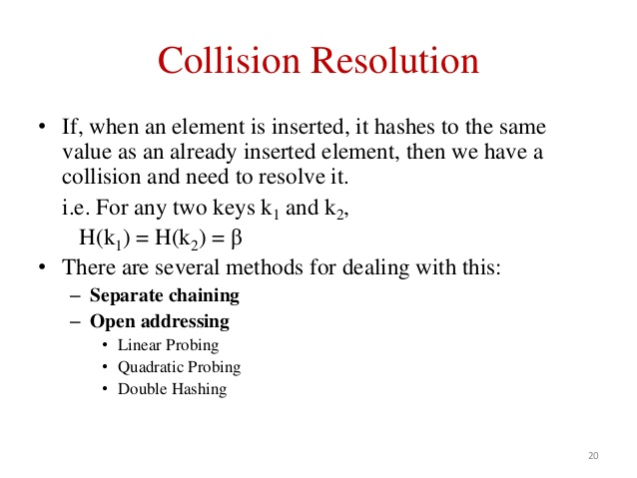
. . .
Notes:
Instead we must somehow mark the location as "a location that used to have something here, but no longer does."
We might do this by using some other special value for the Number field of the record.
In any case, a search can not stop when it reaches "a location that used to have something here". A search can only stop when it reaches a true empty spot.

Slide 16
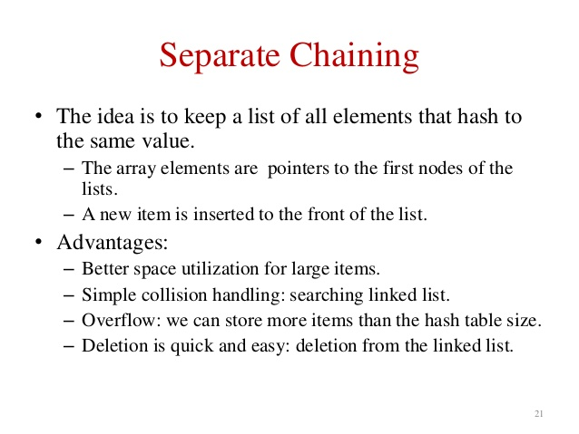
. . .
Notes:
Instead we must somehow mark the location as "a location that used to have something here, but no longer does."
We might do this by using some other special value for the Number field of the record.
In any case, a search can not stop when it reaches "a location that used to have something here". A search can only stop when it reaches a true empty spot.

Slide 17
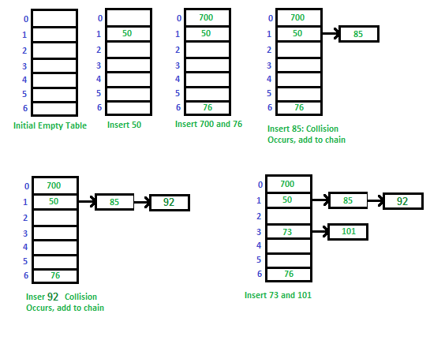
A simple hash function as “key mod 7” and sequence of keys as 50, 700, 76, 85, 92, 73, 101.
Notes:
Instead we must somehow mark the location as "a location that used to have something here, but no longer does."
We might do this by using some other special value for the Number field of the record.
In any case, a search can not stop when it reaches "a location that used to have something here". A search can only stop when it reaches a true empty spot.

Slide 18
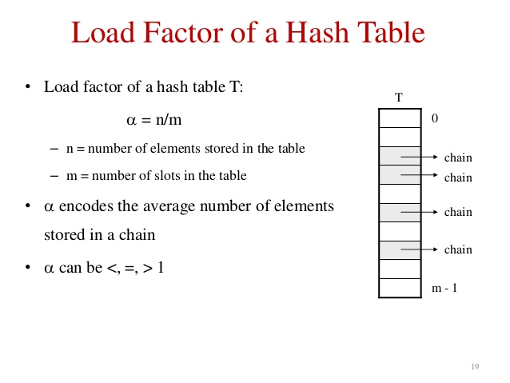
. . .
Notes:
Instead we must somehow mark the location as "a location that used to have something here, but no longer does."
We might do this by using some other special value for the Number field of the record.
In any case, a search can not stop when it reaches "a location that used to have something here". A search can only stop when it reaches a true empty spot.

Slide 19
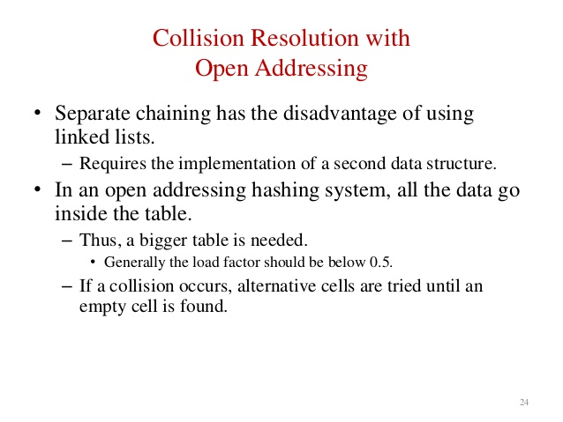
Notes:
A quick summary . . .

Slide 20
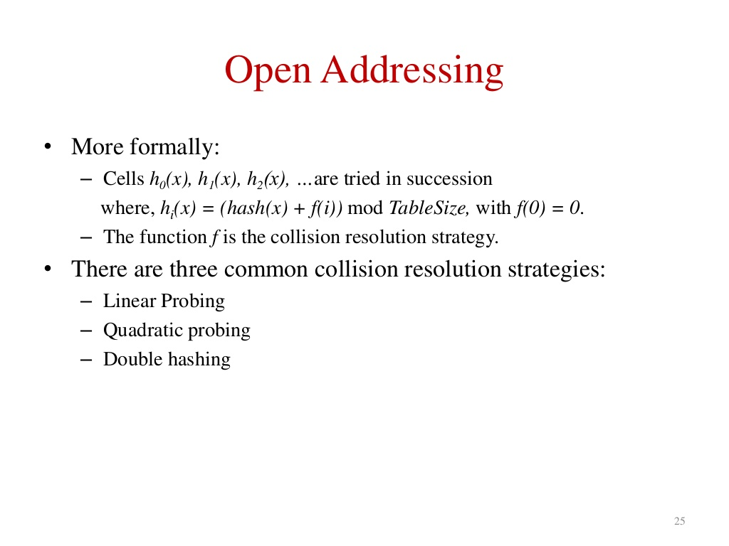
Notes:
A quick summary . . .

Slide 21
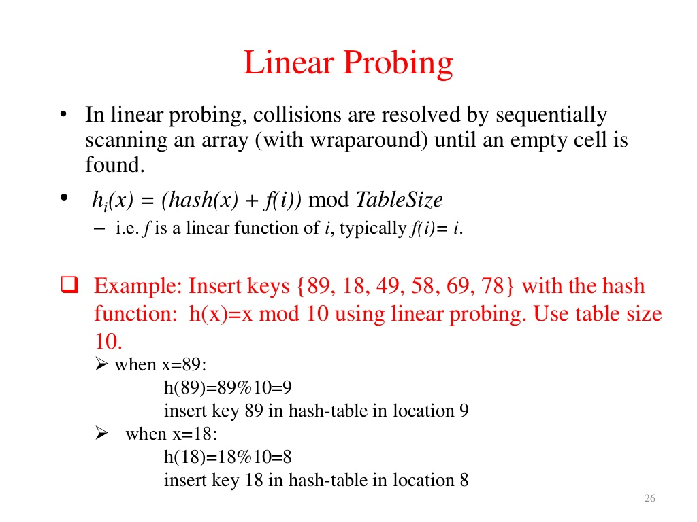
H(X) = X % TS
Notes:
A quick summary . . .

Slide 22
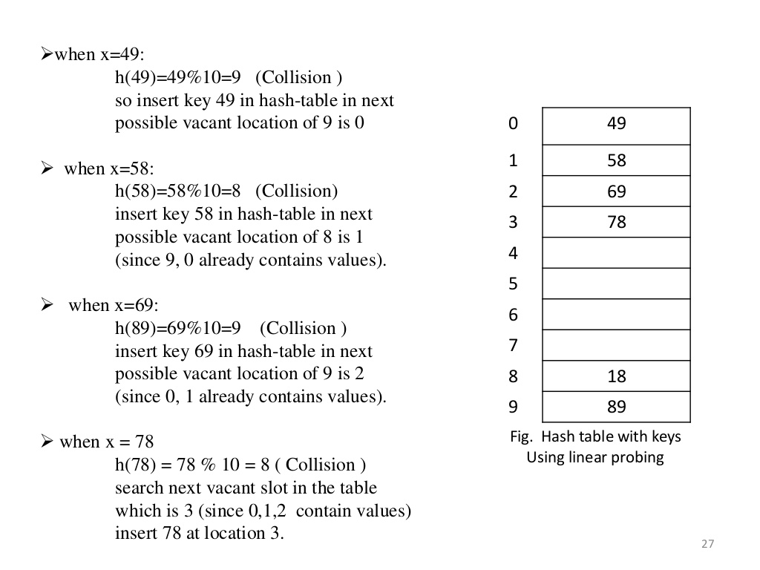
Notes:
A quick summary . . .

Slide 23
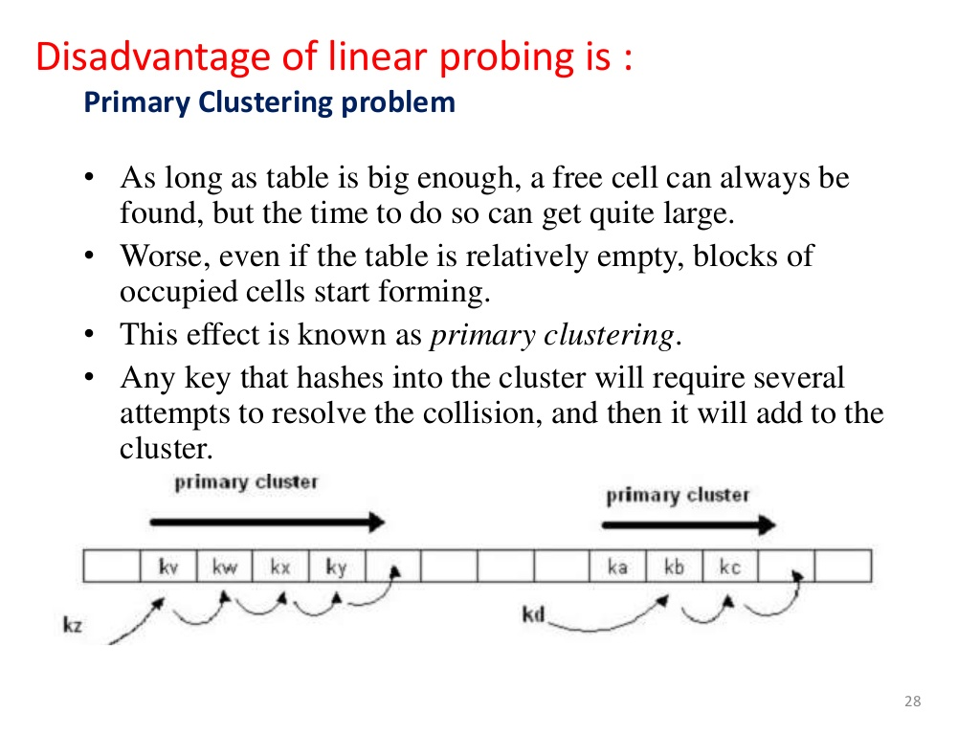
Notes:
A quick summary . . .

Slide 24
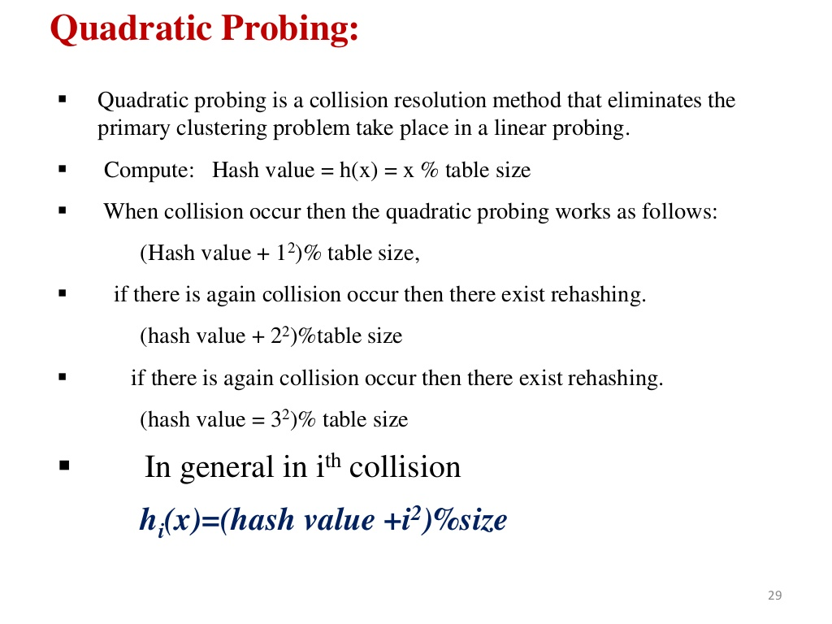
H(X) = X % TS
H_{i}(X) = (H(X) + (i²)) % TS
Notes:
A quick summary . . .

Slide 25
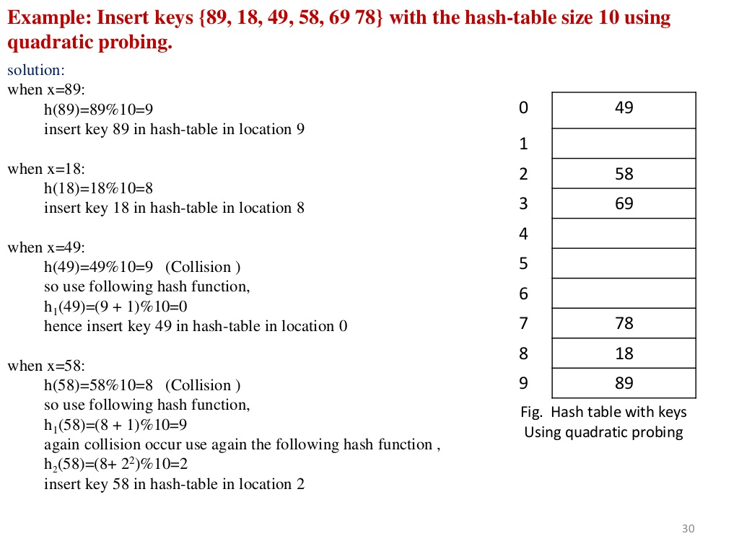
H(X) = X % TS
H_{i}(X) = (H(X) + (i²)) % TS
Notes:
A quick summary . . .

Slide 26
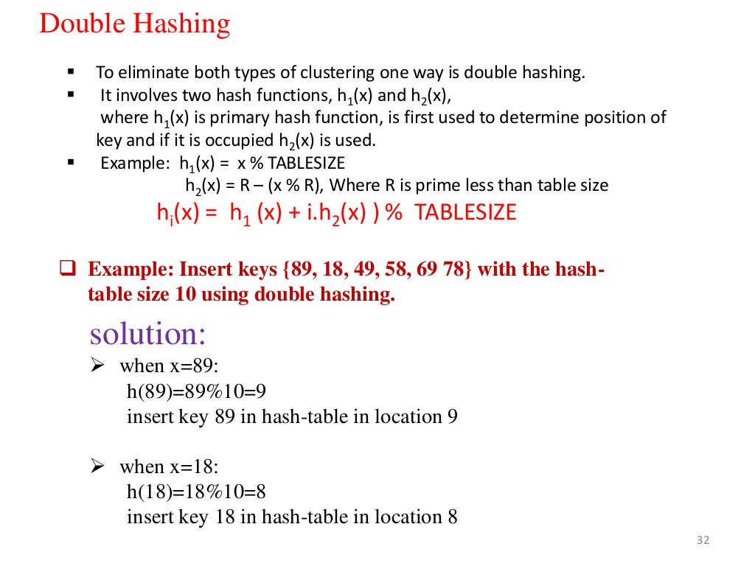
H₁(X) = X % TS
H₂(X) = (X + (R-(X%R)) % TS
H(X) = (H₁(X) +H₂(X)) % TS
R is a prime number & R< table size.
Notes:
A quick summary . . .

Slide 27
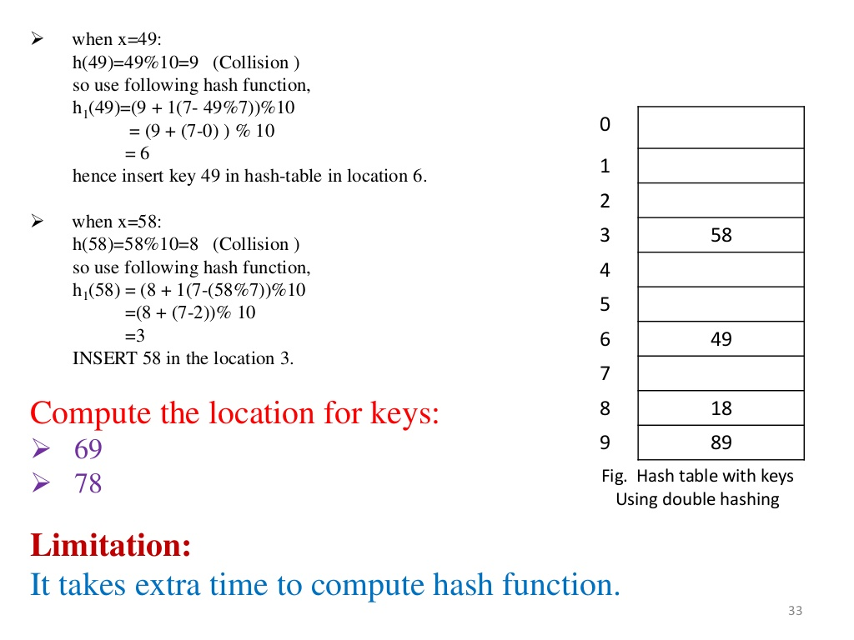
H₁(X) = X % TS
H₂(X) = (X + (R-(X%R)) % TS
H(X) = (H₁(X) +H₂(X)) % TS
R is a prime number & R< table size.
Notes:
A quick summary . . .

